Slide 1
Class 4

Slide 2
Review : Function definition
No parameter function
def func_name ():
blah blash…
With Parameter function
def func_name (n):
Blah blah

Slide 3
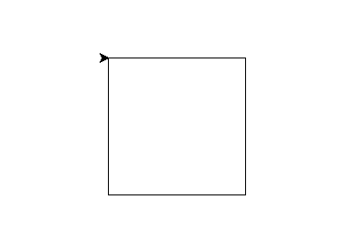
Turtle module to draw graphics
t=turtle.Pen()
for x in range (4):
t.forward(100)
t.right(90)

Slide 4
Problem with Turtle?
Have you heard of the tortoise and the hare?
Tortoise is persistent, not fast
Same with the turtle module

Slide 5
New Graphic Module
from tkinter import *
tk = Tk()
btn = Button (tk, text = “test button”, command = lambda : Nancy (‘first’, ‘second’))
btn.pack()

Slide 6
New syntax to pass values to a function
btn = Button (tk, text = “test button”, command = hello)

